Slide 1
Cloud Adoption Framework for Azure
Niels Ophey
OCP, CSA

Slide 2
Agenda
Digital Transformation
Cloud Adoption Framework for Azure
Tools and Assets
Resources

Slide 3
Digital transformation

Slide 4
76% of CEOs consider DT their #1 priority
Trends that will transform business over the next five years
76%
69%
58%
39%
28%
Technological advances
Demographic shifts
Shift in global economic power
Resource scarcity & climate change
Urbanization
Source: PWC CEO Survey

Slide 5
A modernization strategy drives innovation + growth
80%
Websites running in
Data
minutes
Administration
analysis
Remove patching, network setup, firewall configuration
Enable application innovation
—Forrester TEI of Azure¹
Remove the need to wait for servers²
Improve app delivery time by 50%¹
With cloud, we collect data we couldn’t before
Make personal connections that standout in sea of information
—Anheuser-Busch InBev
Organizations that harness data, the cloud, and AI outperform their peers³
2x
$100M
~
operating margin
additional
operating income
¹The Total Economic Impact™ Of Microsoft Azure Platform-As-A Service, Forrester Consulting, June 2016
³Source: Keystone Strategy interviews Oct 2015 - Mar 2016

Slide 6
It requires new and disruptive thinking
…but change is difficult. We understand this impacts people, culture, and can feel risky.
It requires leaders to adapt, take risks, and learn quickly
It requires a culture shift from within the organization

Slide 7

Modern business in the cloud is the new normal
Today’s world reflects a new reality:
Technology is ever-present through the cloud, offering easy access to digital services…
Capitalizing on this shift is key for the organization’s innovation and growth

Slide 8
Microsoft Cloud Adoption Framework for Azure

Slide 9
Microsoft Cloud Adoption Framework for Azure
Best practices
Templates
People
Process
Technology
Documentation
Tools
Achieve balance
Align business, people and technology strategy to achieve business goals with actionable, efficient, and comprehensive guidance to deliver fast results with control and stability.

Slide 10
Building the framework
Modular approach, meeting the customer in their journey
Strategy
Plan
Ready
Adopt
Govern
Manage

Slide 11
Define strategy
Define strategy
Plan
Ready
Adopt
Documenting the cloud strategy will help business stakeholders and technicians understand the benefits the organization is pursuing by adopting the cloud.
Govern
Manage
Motivations
Executive mandate
DC Exit
Merger and acquisitions
Cost savings
Optimization
Agility
Tech capabilities
Market demands
Geo expansion
Migration
Innovation
Business outcomes
Fiscal: revenue, cost, profit
Agility: timer to market, provisioning,
Reach: global access, sovereignty
Customer engagement: cycle time, from request to release
Performance: SLAs, Downtime, operations, reliability
Business justification
Business case: the cloud is not always cheaper, mirroring is not cloud, servers drive cost analysis
Financial model: Capex/ Opex, ROI, gain, cost avoidance/reduction
Cloud accounting: cost center, procurement, profit center, revenue generating, chargeback
First project
Business criteria: workload supported by a BDM
Technical criteria: minimum dependencies and test path, no governance
Qualitative analysis: Current Team analysis

Slide 12
Plan
Define strategy
Plan
Ready
Adopt
Cloud adoption plans convert the aspirational goals of the cloud adoption strategy into actions. It will help guide technical efforts, in alignment with the business strategy.
Govern
Manage
Digital estate
Rationalization: inventory
Quantitative analysis: asset optimized and sized properly
Qualitative analysis: operational process
Initial organization alignment
Cloud Strategy Team
Business IT: requirements and needs
IT management operations: traditional IT
Governance: executive sponsor, finance, business leadership, legal, security, HR
Cloud platform vendor: account success team
Cost management
IT-business alignment
Governance MVP
Skill readiness plan
Organizational readiness
Governance and security alignment
Initial organization alignment
Building technical skills: business/technical, and certifications
Change management guidance
Cloud adoption plan
5R strategy: rehost, refactor, rearchitect, rebuild, replace
Infrastructure migration: VM, server, database focus
Application innovation: born in the cloud applications, APIs
Data-driven innovation: Focus on data consolidation and analysis

Slide 13
Ready
Define strategy
Plan
Ready
Adopt
Ready establishes a cloud foundation or Adoption Target that can provide hosting for any adoption efforts. This should consist of common denominators across 80–90% of cloud adoption.
Govern
Manage
Azure readiness guide
Resource management: management groups, subscriptions, resource groups, resources tree hierarchy
Naming Standards
Resource tags
Landing zone infrastructure
Network design: Vnet, hybrid, firewall, hub, front door, endpoints
Storage design: disk, file, blobs, CDN
Compute design: VMs, containers, apps, serverless
Data design: Structured/ unstructured
Landing zone ID
Identity and access
Role-based access control RBAC
Manage to least privilege
Landing zone cost
Costs and billing
Analyze Cloud Costs
Monitor with budgets
Optimize with recommendations
Manage invoices and payments
Blueprints
AI
BigData
Hybrid networks
Identity management
IoT
Serverless
SAP
VMs
WebApps
DevOps

Slide 14
Adopt: Migrate
Define strategy
Plan
Ready
Adopt
Cloud adoption will include workloads which do not warrant significant investments in the creation of new business logic. These workloads are candidates for migration to the cloud.
Govern
Manage
Assess
Evaluate assets and establish a plan
Validate pre-requisites: landing zone, skilling
Drivers: reducing capex, freeing up DC
Quantitative factors: VMs, networking, compatibility
Qualitative factors: process dependencies, critical business events
Migrate: rehost
Replicate (lift and shift) on-prem functionality using cloud native technology
Leverage Azure Migration Guide
Optimize
Balance performance and price
Deliver the right experience within budget
Resize VM size, resize storage, resize database
Secure and manage
Prepare the migrated asset for ongoing operations: security, monitoring, configuration

Slide 15
Adopt: Innovate
Define strategy
Plan
Ready
Adopt
Older apps can take advantage of many of the same cloud-native benefits by modernizing the solution or components of the solution. Modern DevOps invites into the process to create shorter feedback loops and better customer experiences.
Govern
Manage
Infrastructure abstraction
Cloud native applications built from the ground up optimized for cloud:
Resiliency
Global scale
Agility
Security
Autoscaling
Innovate: refactor
Refactoring an application to fit a PaaS/Serverless-based model or refactoring code to deliver on new business opportunities.
Drivers: faster and shorter updates, code portability, greater cloud efficiency (resources, speed, cost)
Innovate: rearchitect
Modify existing applications into managed containers to take advantage of cloud native benefits
Drivers: application scale and agility, easier adoption of new cloud capabilities, mix of technology stacks
Innovate: rebuild
A new code base is created to align with a cloud-native approach. App Data and AI Services
Drivers: accelerate innovation, build apps faster, reduce operational cost
DevOps
Culture
Development
Testing
Release
Monitoring
Management

Slide 16
Govern
Define strategy
Plan
Ready
Adopt
Policy definition ensures consistency across adoption efforts. Alignment to governance/compliance requirements is key to maintain a well-managed cross-cloud environment.
Govern
Manage
Business risk
Document evolving business risk
Document risk tolerance based on data classification, and application criticality
Policy & compliance
Convert risk decisions into policy statements
Establish cloud adoption boundaries
Processes
Establish processes to monitor violations
Adhere to corporate policies
Cloud Center of Excellence
Cost management
Evaluate and monitor cost
Limit IT spend
Scale based on business demand
Create cost accountability
Security baseline
Compliance with IT Security requirements
Apply security baseline to all adoption efforts
Resource consistency
Consistency in resource configuration
Enforce on boarding, recovery and discoverability practices
Identity baseline
Enforce identity and access baseline
Apply role definitions and assignments
Deployment acceleration
Centralize templates
Drive consistency and standardization

Slide 17
Manage and operations
Define strategy
Plan
Ready
Adopt
Manage and operations enumerates, implements, and iteratively reviews related to the expected operational behavior of the service.
Govern
Manage
Management
Identify critical operations for business operations
Map operations to services
Analyze services dependencies
Create high level view service dashboards
Monitoring
Enable data collection
Identify operations baseline
Generate alerts
Measure Service Metrics and generate SLAs
Resiliency
Enable a resilient platform
Recover from failures with minimal downtime and minimum data loss before
Evolve to a highly available platform

Slide 18
Microsoft Cloud Adoption Framework for Azure
Adopt
Define Strategy
Understand motivations
Business outcomes
Business justification
Prioritize project
Plan
Digital estate
Initial organization alignment
Skills readiness plan
Cloud adoption plan
Ready
Azure readiness guide
First landing zone
Expand the blueprint
Best practice Validation
Migrate
• First workload migration
• Expanded scenarios
• Best practice validation
• Process improvements
Innovate
• Innovation guide
• Expanded scenarios
• Best practice validation
• Process improvements
Govern
Methodology • Benchmark
initial best practice • Governance maturity
Manage
Business commitments
operations baseline • Ops maturity

Slide 19
Tools and Assets

Slide 20

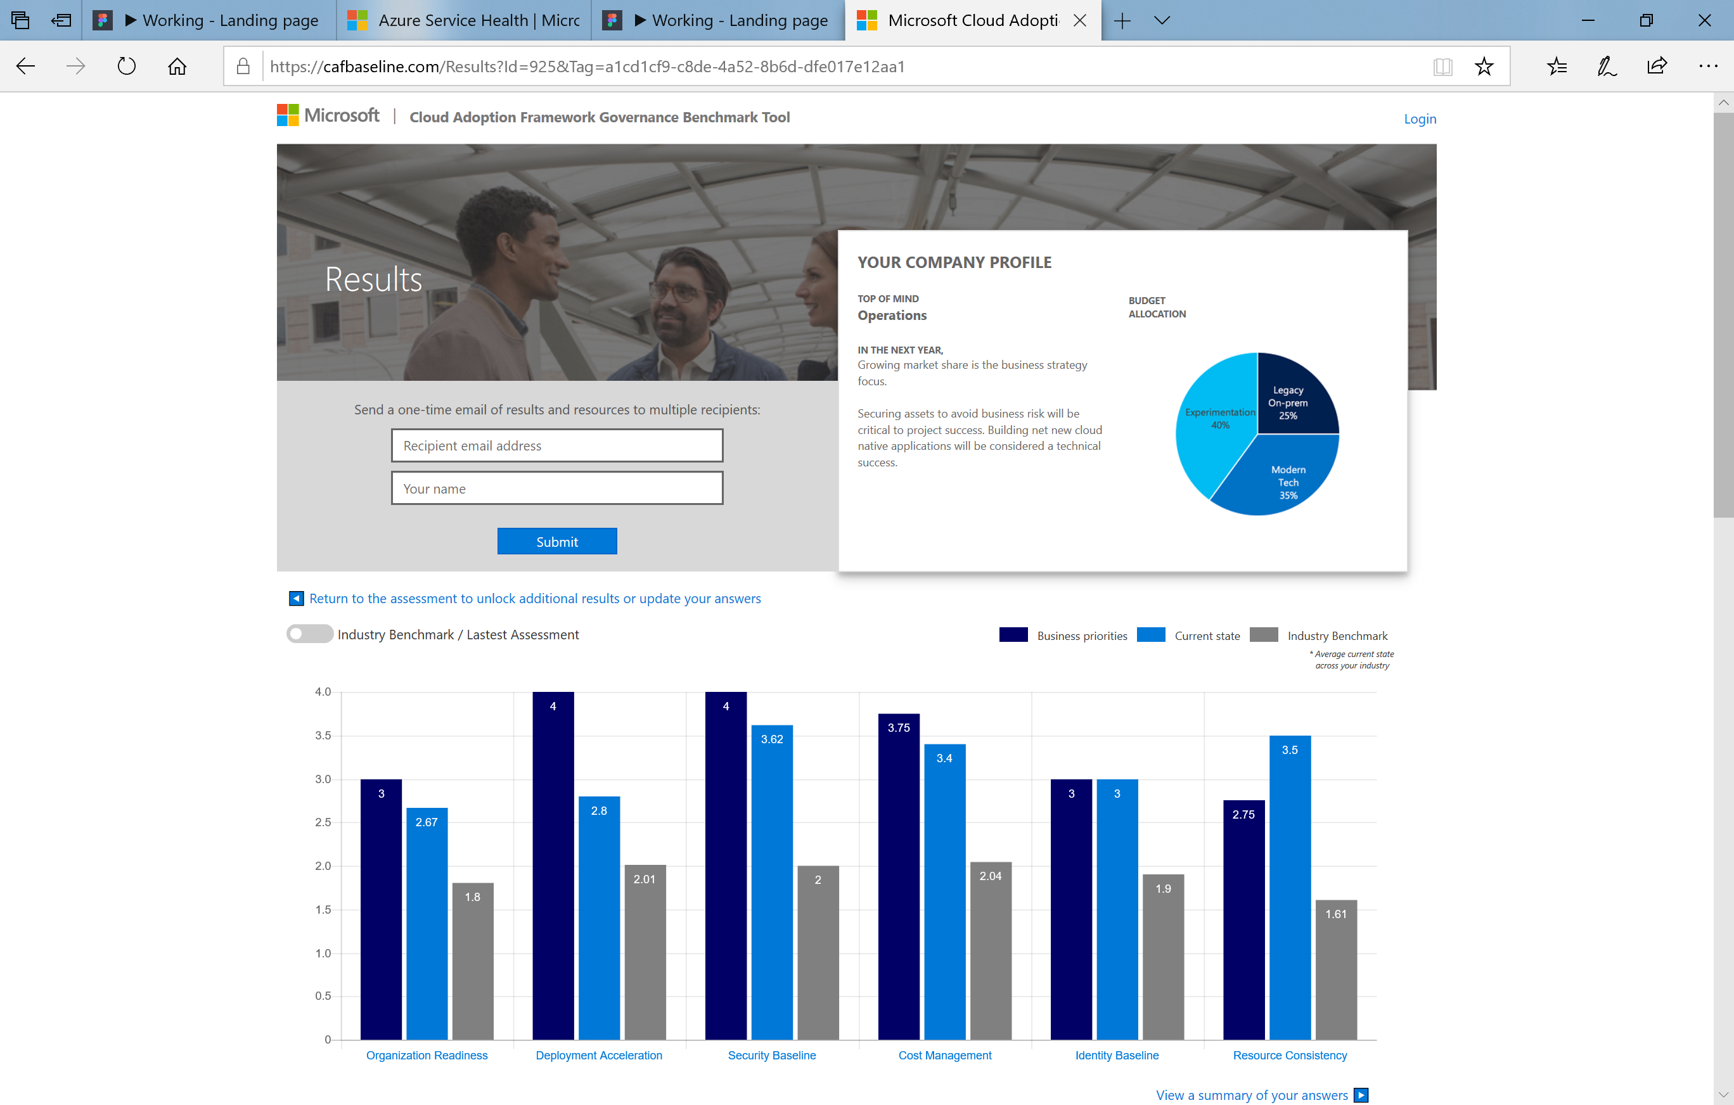
Understand your current state and prepare for your cloud journey using
the Governance benchmark tool http://aka.ms/adopt/gov/assess

Slide 21
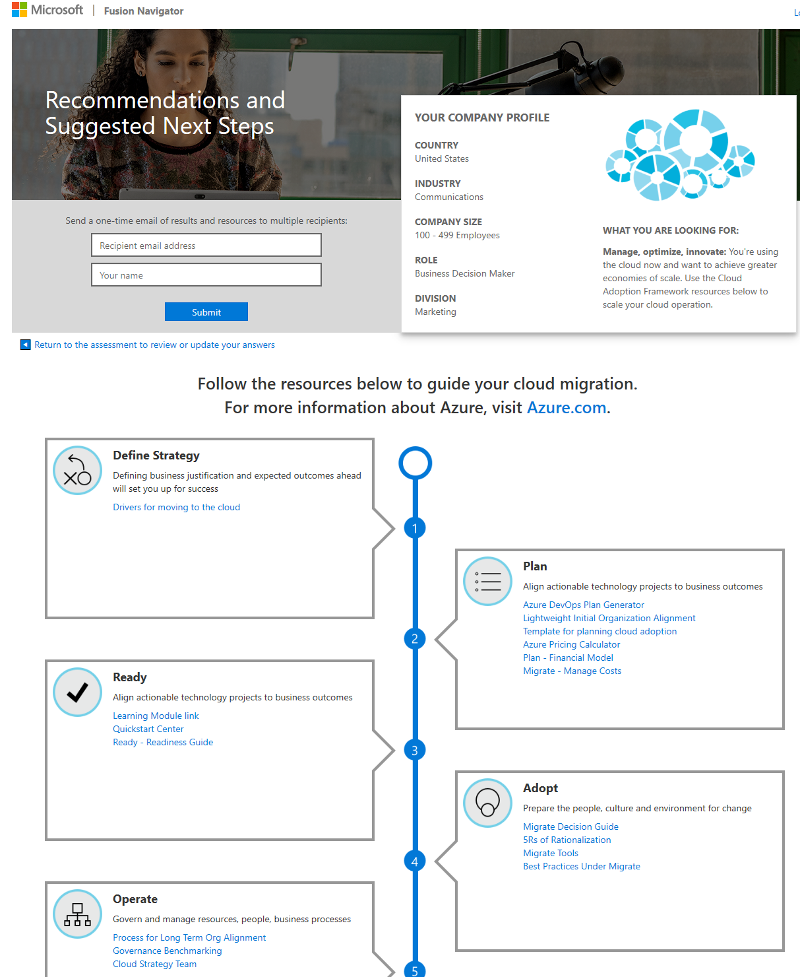
Navigate to the most relevant adoption content efficiently, and detect early adoption blockers using
the Fusion Navigator tool aka.ms/fusionnavigator
Give us feedback
aka.ms/fusionnavigator/givefeedback

Slide 22
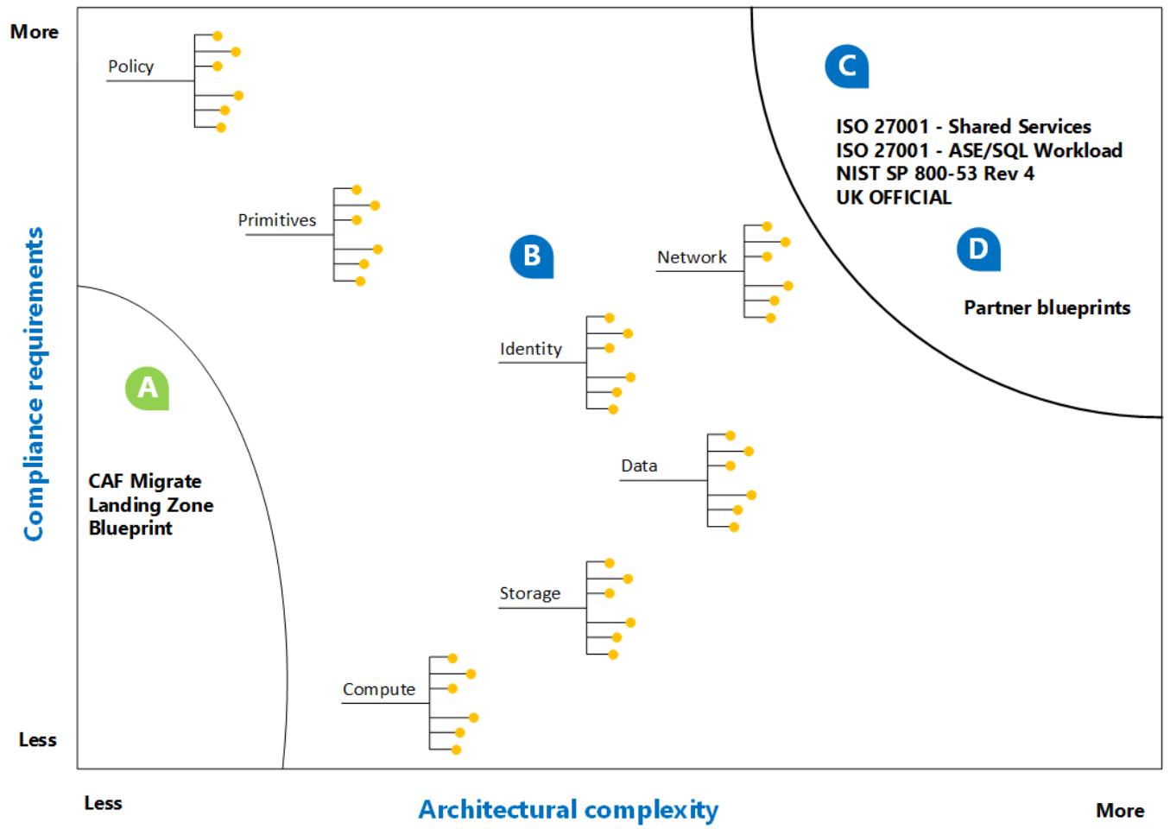
Migrate landing zone blueprint aka.ms/adopt/landingzone
Start with consistent infrastructure-as-code blueprints. Change only what needs to be changed to get to business value faster.
https://aka.ms/adopt/Plan

Slide 23
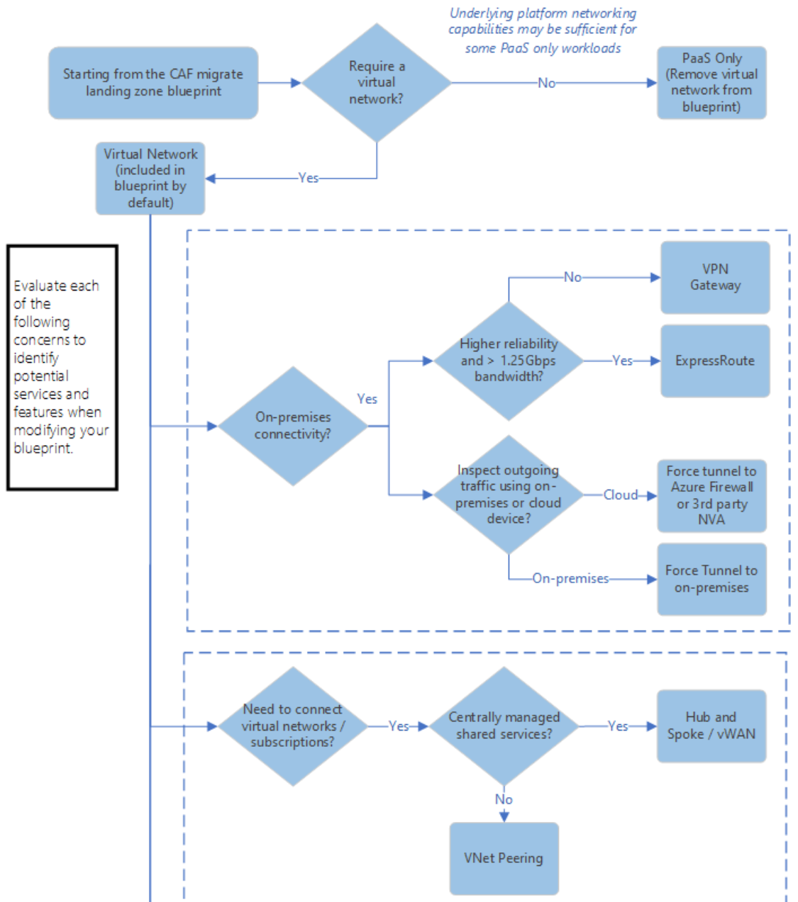
Landing zone decision guides aka.ms/adopt/landingzone
Leverage decision guides to quickly align blueprints with customer requirements.
https://aka.ms/adopt/Plan

Slide 24
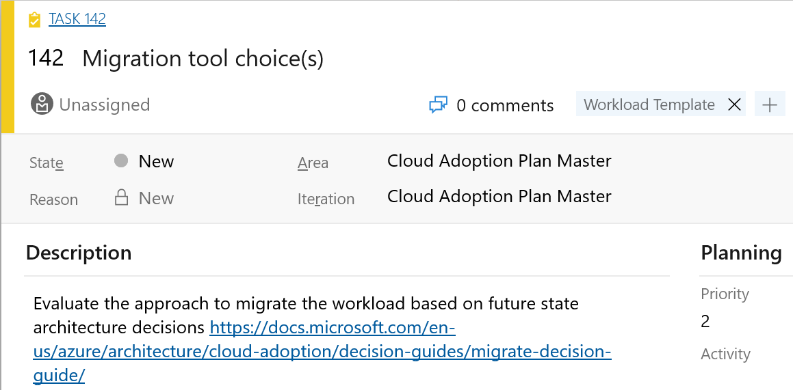
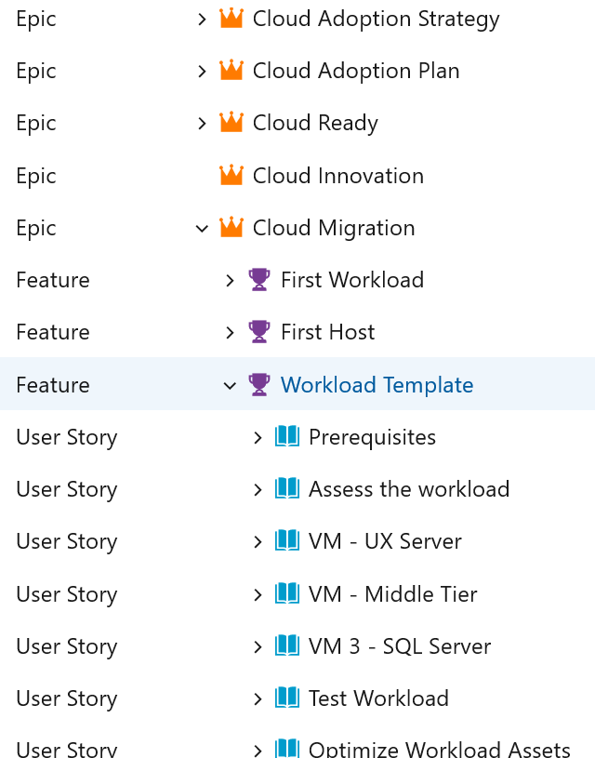
Cloud Adoption Plan aka.ms/adopt/plan
Align business strategy with an actionable cloud adoption plan which maps tasks to published guidance.
https://aka.ms/adopt/Plan

Slide 25

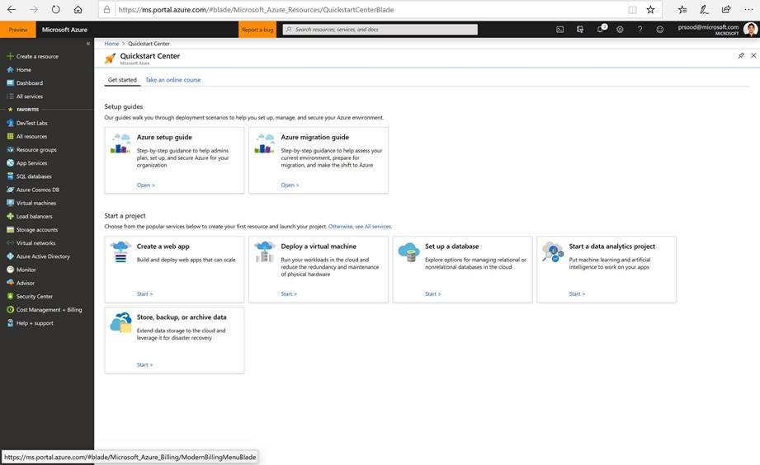

Azure Setup Guide
Azure Migration Guide
Implementation Guides are available in Azure Quickstart Center inside the Azure portal (portal.azure.com)

Slide 26
Resources

Slide 27
Resources
Where
What
MS Learn
Learning module
MS Docs
Cloud Adoption Framework for Azure
Governance Benchmark tool
Q&A based tool to assess current and desired state on cloud governance
Azure Architecture Center
Examples, reference architectures, microservices design, data architectures, app innovation design guides
Azure Expert MSP
Partners already trained and/or with offerings aligned to Cloud Adoption Framework for Azure
MCS
Microsoft Consulting Services offering: Azure Cloud Foundation

